Slide 1
CrAg Reflex Test Screening Percentage Coverage
National Reflex CrAg Screening (Q4 2016-Q3 2017) | Year Total CD4<100 | Year Total reflex Screening | CrAg Test Screening Yearly % Coverage
Gauteng | 78213 | 74844 | 96%
Kwazulu Natal | 62652 | 60420 | 96%
Eastern Cape | 33290 | 31807 | 96%
Western Cape | 20198 | 18725 | 93%
Limpopo | 24492 | 24033 | 98%
North West | 22391 | 18659 | 83%
Northern Cape | 5950 | 5418 | 91%
Mpumalanga | 27634 | 26498 | 96%
Free State | 16309 | 15721 | 96%
Total year CrAg Reflex Coverage | 291129 | 276125 | 95%

Slide 2
National CrAg Reflex Screening Report (Quarter 4 2016-Quarter 3 2017)

Slide 3
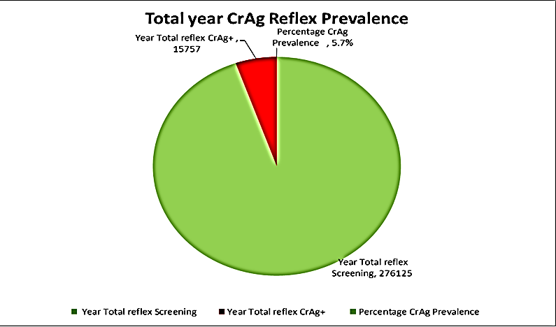

Slide 4
National Reflex CrAg Screening by Province (Q4 2016-Q3 2017)

Slide 5
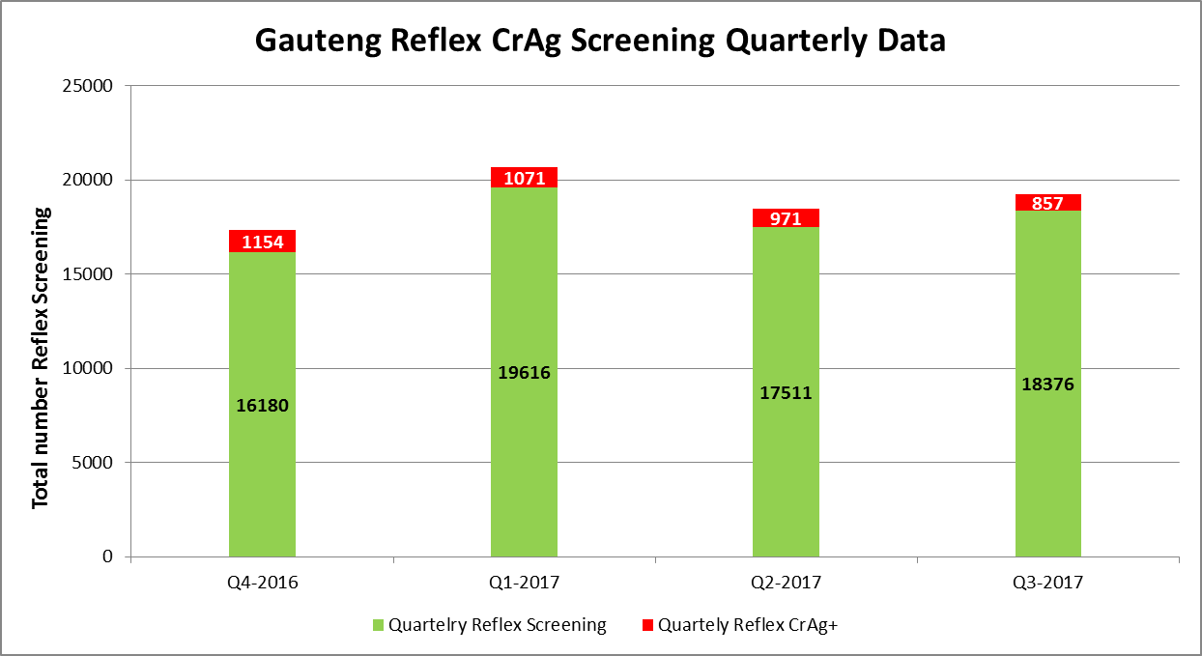
Gauteng Province | Quartelry Reflex Screening | Quartely Reflex CrAg+
Q4-2016 | 16180 | 1154
Q1-2017 | 19616 | 1071
Q2-2017 | 17511 | 971
Q3-2017 | 18376 | 857

Slide 6
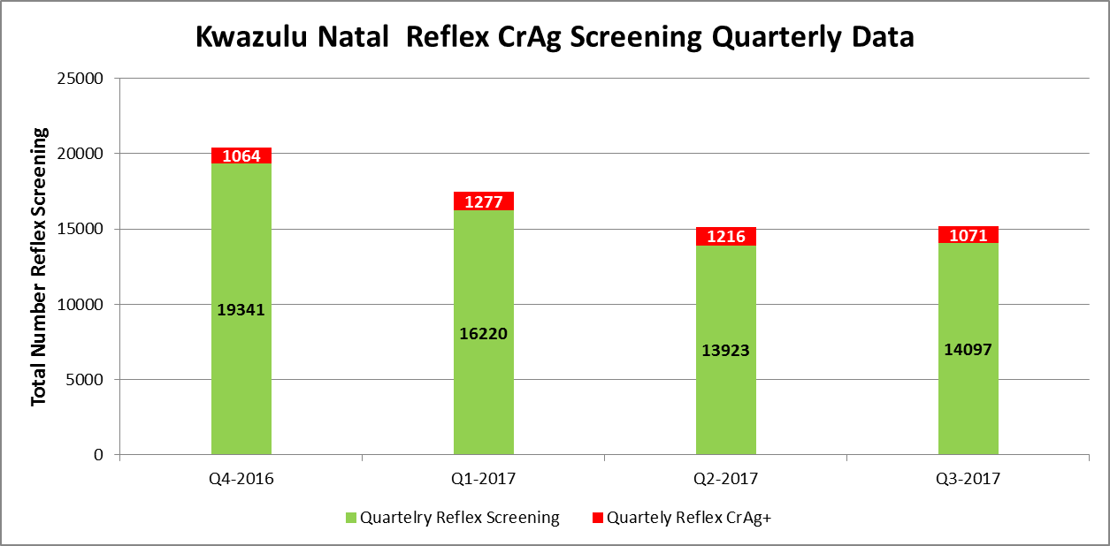
Kwazulu Natal Province | Quartelry Reflex Screening | Quartely Reflex CrAg+
Q4-2016 | 19341 | 1064
Q1-2017 | 16220 | 1277
Q2-2017 | 13923 | 1216
Q3-2017 | 14097 | 1071

Slide 7
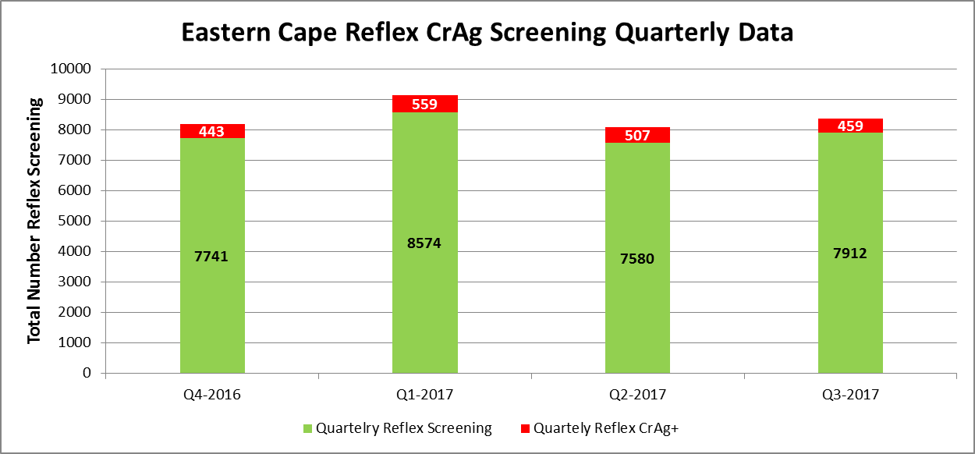
Eastern Cape | Quartelry Reflex Screening | Quartely Reflex CrAg+
Q4-2016 | 7741 | 443
Q1-2017 | 8574 | 559
Q2-2017 | 7580 | 507
Q3-2017 | 7912 | 459

Slide 8
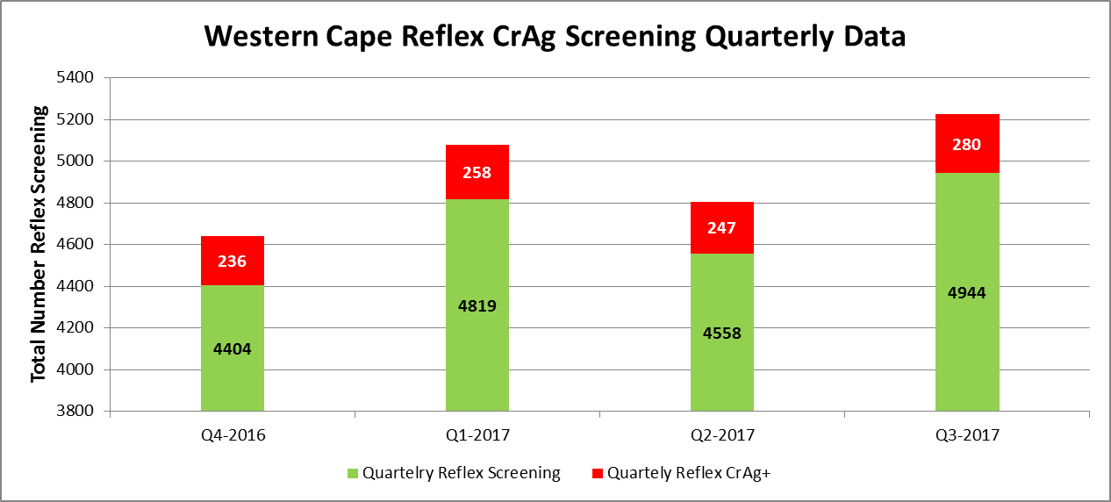
Western Cape | Quartelry Reflex Screening | Quartely Reflex CrAg+
Q4-2016 | 4404 | 236
Q1-2017 | 4819 | 258
Q2-2017 | 4558 | 247
Q3-2017 | 4944 | 280

Slide 9
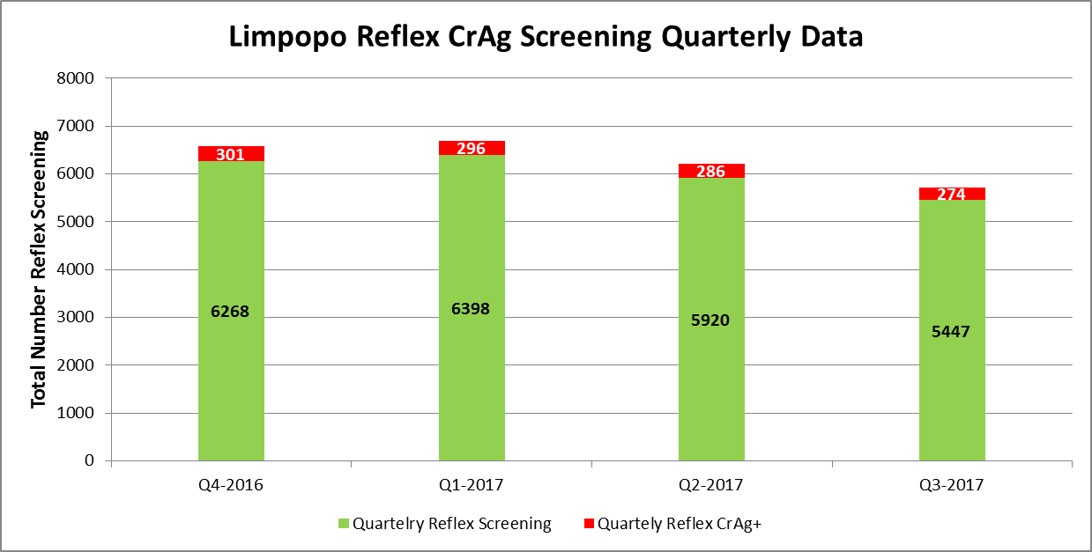
Limpopo | Quartelry Reflex Screening | Quartely Reflex CrAg+
Q4-2016 | 6268 | 301
Q1-2017 | 6398 | 296
Q2-2017 | 5920 | 286
Q3-2017 | 5447 | 274

Slide 10
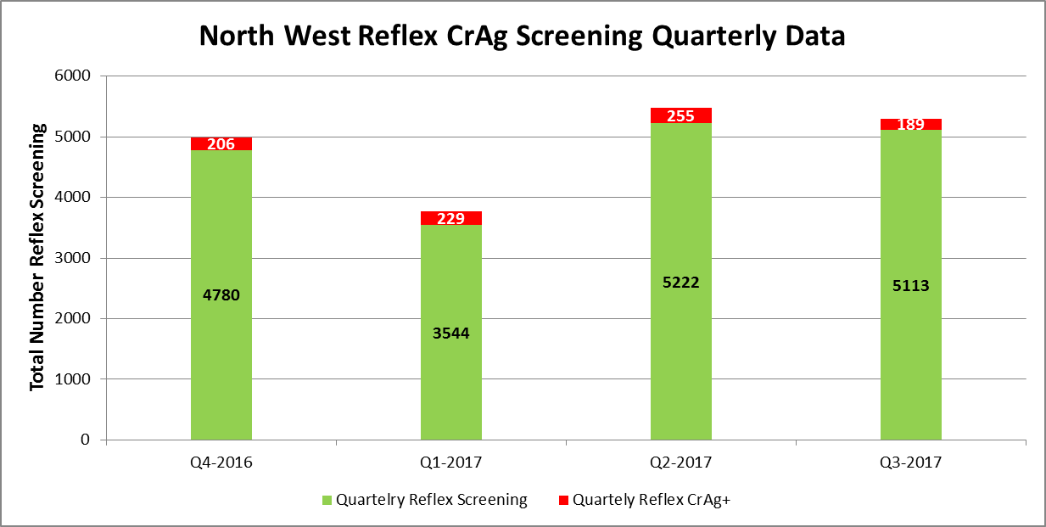
North West | Quartelry Reflex Screening | Quartely Reflex CrAg+
Q4-2016 | 4780 | 206
Q1-2017 | 3544 | 229
Q2-2017 | 5222 | 255
Q3-2017 | 5113 | 189

Slide 11
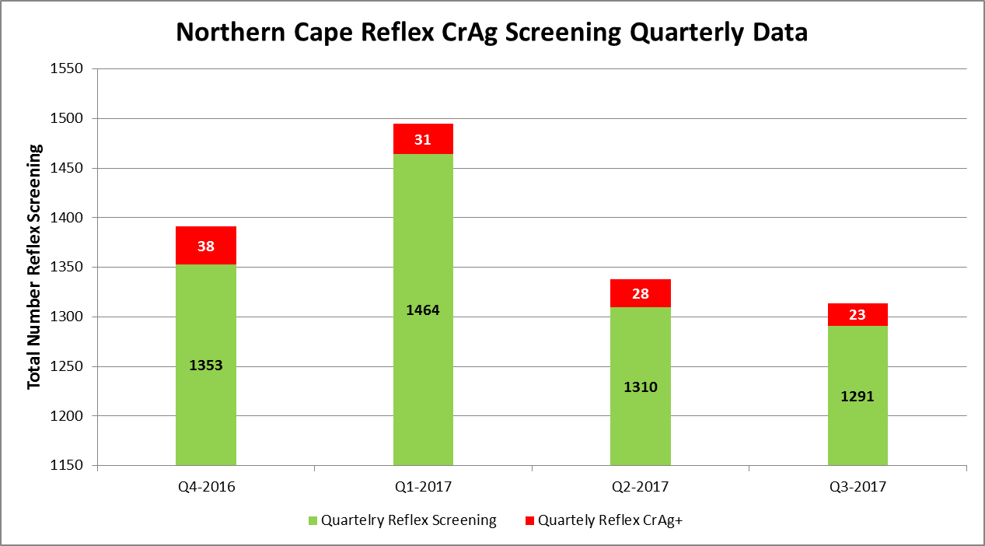
Northern Cape | Quartelry Reflex Screening | Quartely Reflex CrAg+
Q4-2016 | 1353 | 38
Q1-2017 | 1464 | 31
Q2-2017 | 1310 | 28
Q3-2017 | 1291 | 23

Slide 12
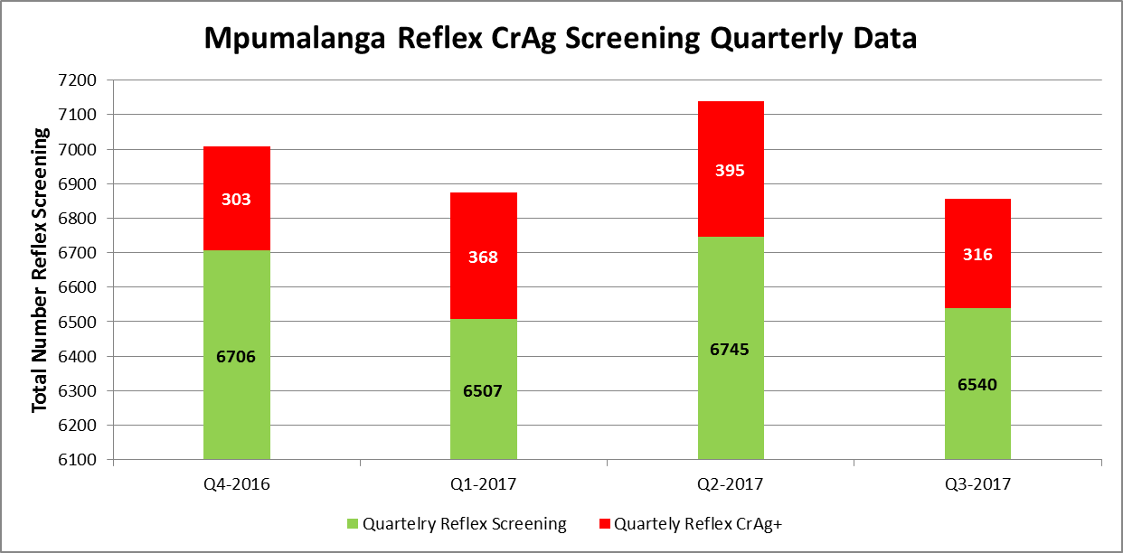
Mpumalanga | Quartelry Reflex Screening | Quartely Reflex CrAg+
Q4-2016 | 6706 | 303
Q1-2017 | 6507 | 368
Q2-2017 | 6745 | 395
Q3-2017 | 6540 | 316

Slide 13
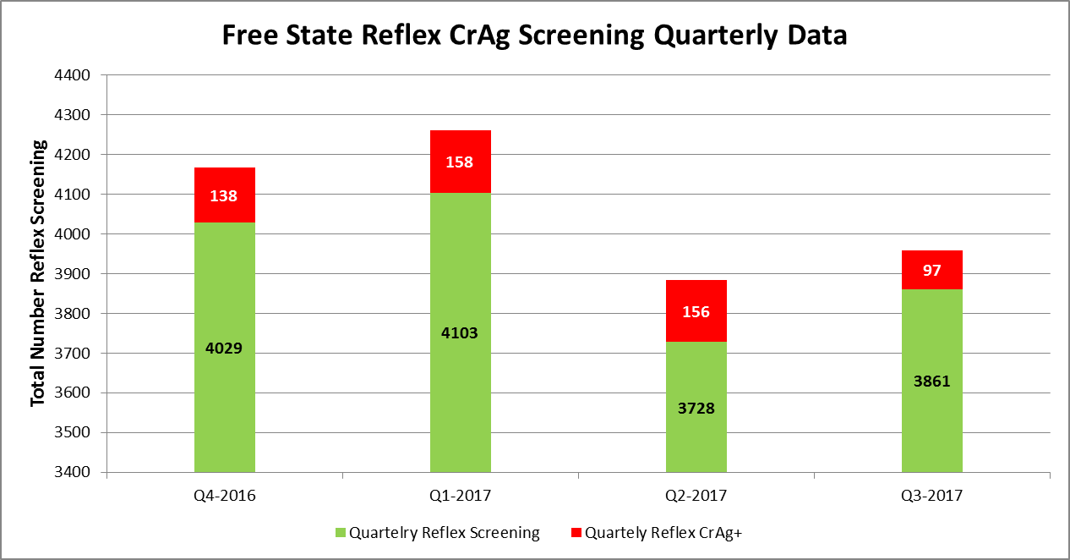
Free State | Quartelry Reflex Screening | Quartely Reflex CrAg+
Q4-2016 | 4029 | 138
Q1-2017 | 4103 | 158
Q2-2017 | 3728 | 156
Q3-2017 | 3861 | 97

