Slide 1
National CrAg Reflex Screening Report (Quarter 4 2016-Quarter 3 2017)

Slide 2
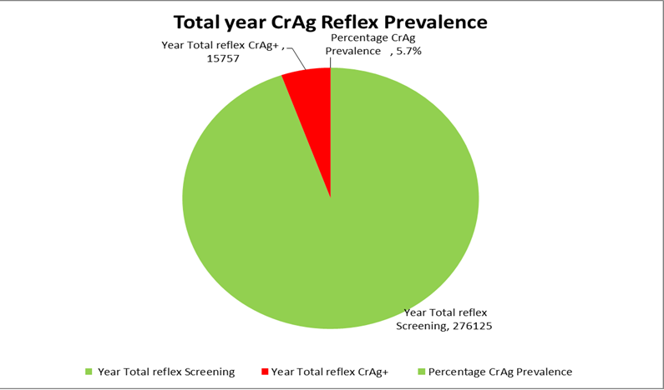

Slide 3
National Reflex CrAg Screening by Province (Q4 2016-Q3 2017)

Slide 4
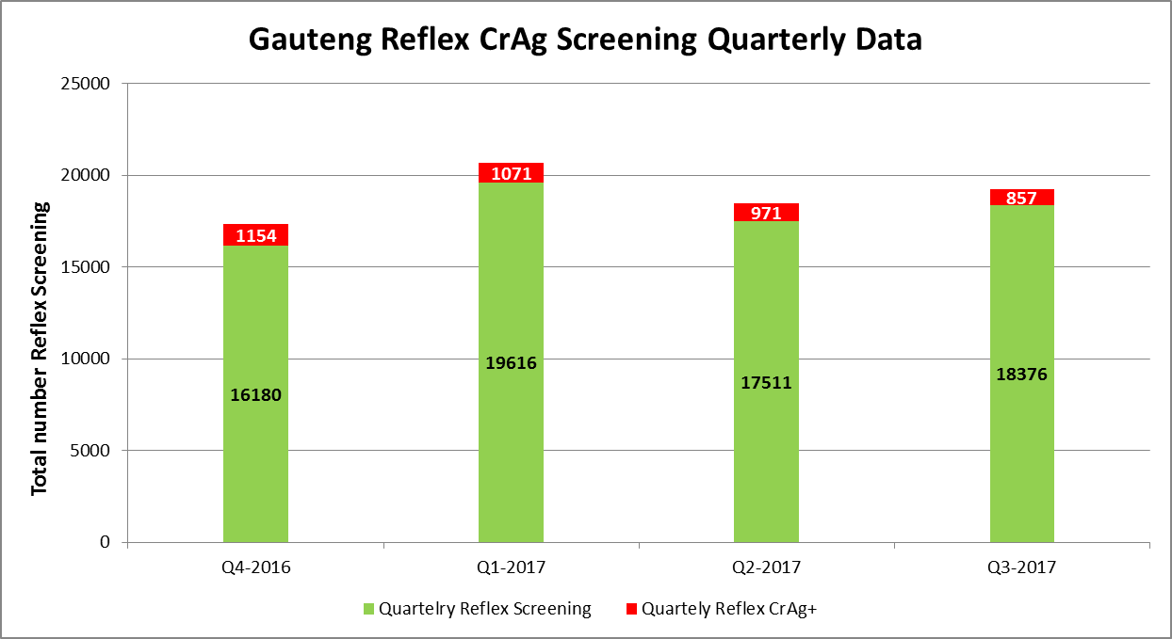
Gauteng Province | Quartelry Reflex Screening | Quartely Reflex CrAg+
Q4-2016 | 16180 | 1154
Q1-2017 | 19616 | 1071
Q2-2017 | 17511 | 971
Q3-2017 | 18376 | 857

Slide 5
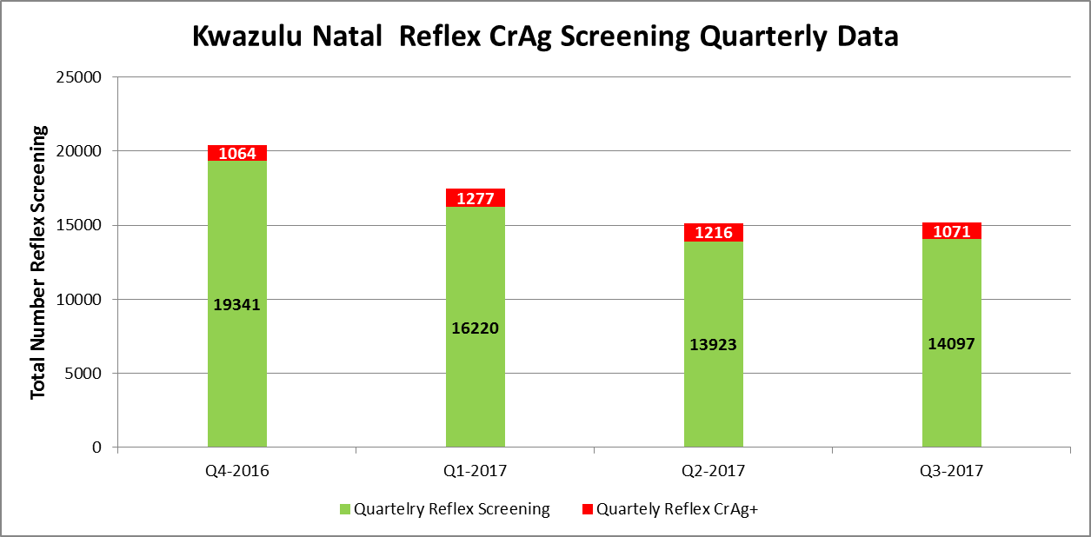
Kwazulu Natal Province | Quartelry Reflex Screening | Quartely Reflex CrAg+
Q4-2016 | 19341 | 1064
Q1-2017 | 16220 | 1277
Q2-2017 | 13923 | 1216
Q3-2017 | 14097 | 1071

Slide 6
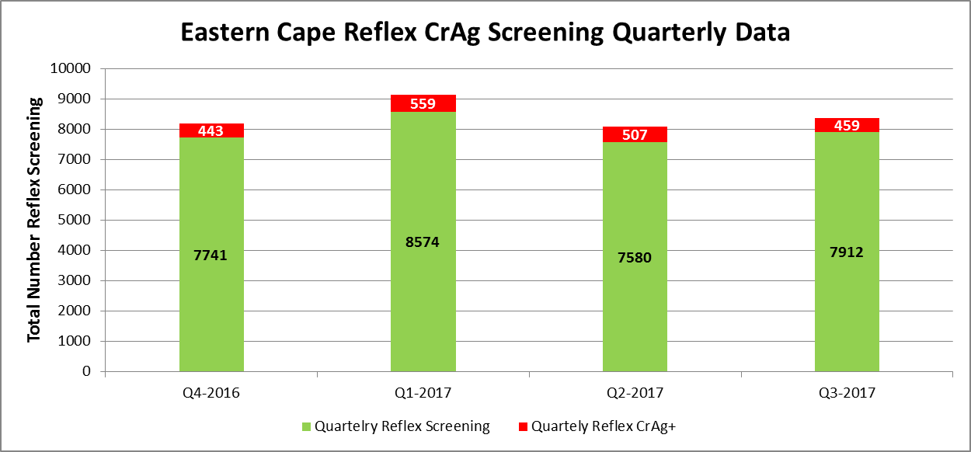
Eastern Cape | Quartelry Reflex Screening | Quartely Reflex CrAg+
Q4-2016 | 7741 | 443
Q1-2017 | 8574 | 559
Q2-2017 | 7580 | 507
Q3-2017 | 7912 | 459

Slide 7
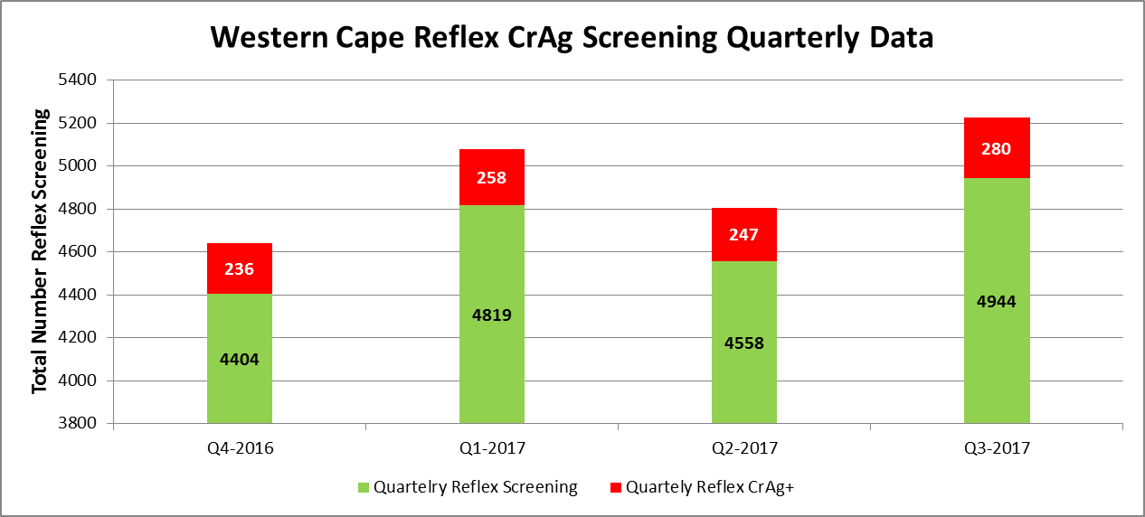
Western Cape | Quartelry Reflex Screening | Quartely Reflex CrAg+
Q4-2016 | 4404 | 236
Q1-2017 | 4819 | 258
Q2-2017 | 4558 | 247
Q3-2017 | 4944 | 280

Slide 8
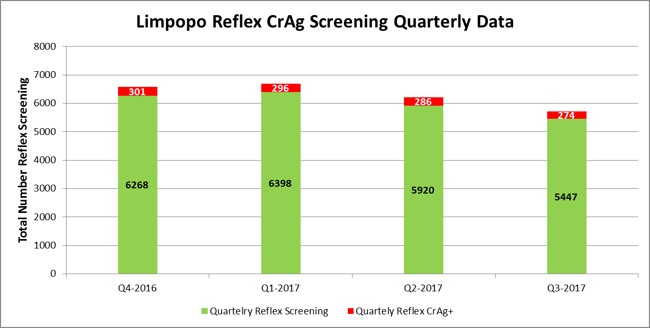
Limpopo | Quartelry Reflex Screening | Quartely Reflex CrAg+
Q4-2016 | 6268 | 301
Q1-2017 | 6398 | 296
Q2-2017 | 5920 | 286
Q3-2017 | 5447 | 274

Slide 9
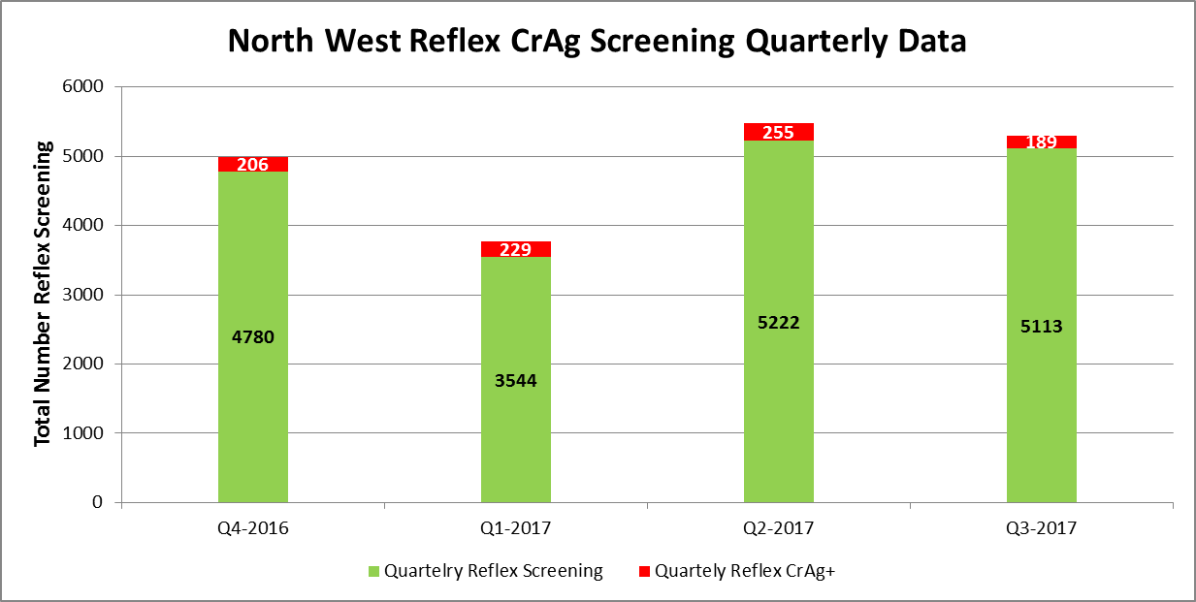
North West | Quartelry Reflex Screening | Quartely Reflex CrAg+
Q4-2016 | 4780 | 206
Q1-2017 | 3544 | 229
Q2-2017 | 5222 | 255
Q3-2017 | 5113 | 189

Slide 10
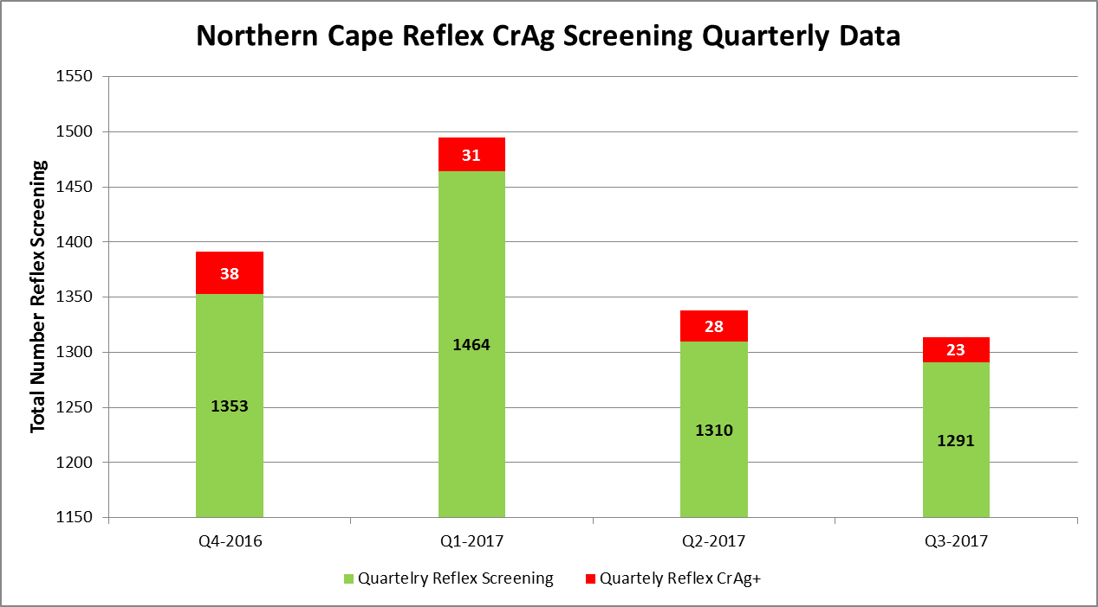
Northern Cape | Quartelry Reflex Screening | Quartely Reflex CrAg+
Q4-2016 | 1353 | 38
Q1-2017 | 1464 | 31
Q2-2017 | 1310 | 28
Q3-2017 | 1291 | 23

Slide 11
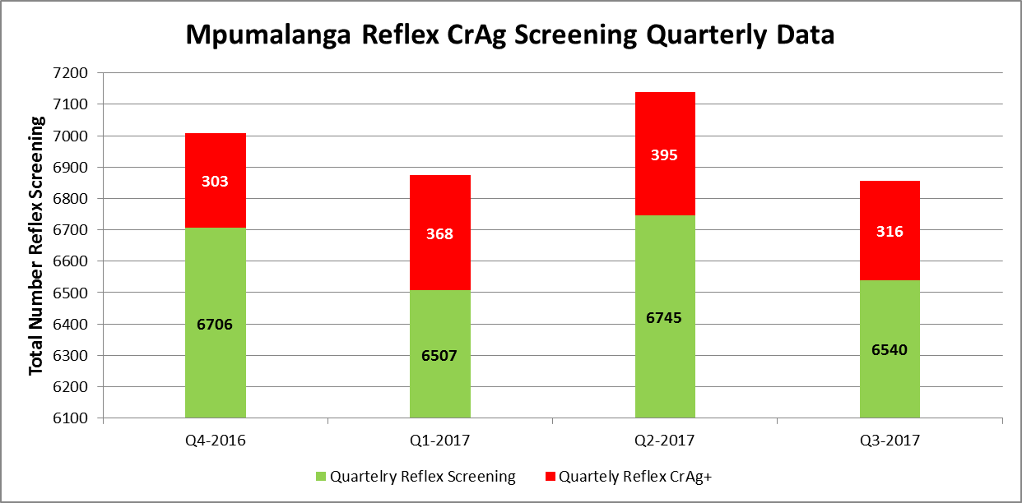
Mpumalanga | Quartelry Reflex Screening | Quartely Reflex CrAg+
Q4-2016 | 6706 | 303
Q1-2017 | 6507 | 368
Q2-2017 | 6745 | 395
Q3-2017 | 6540 | 316

Slide 12
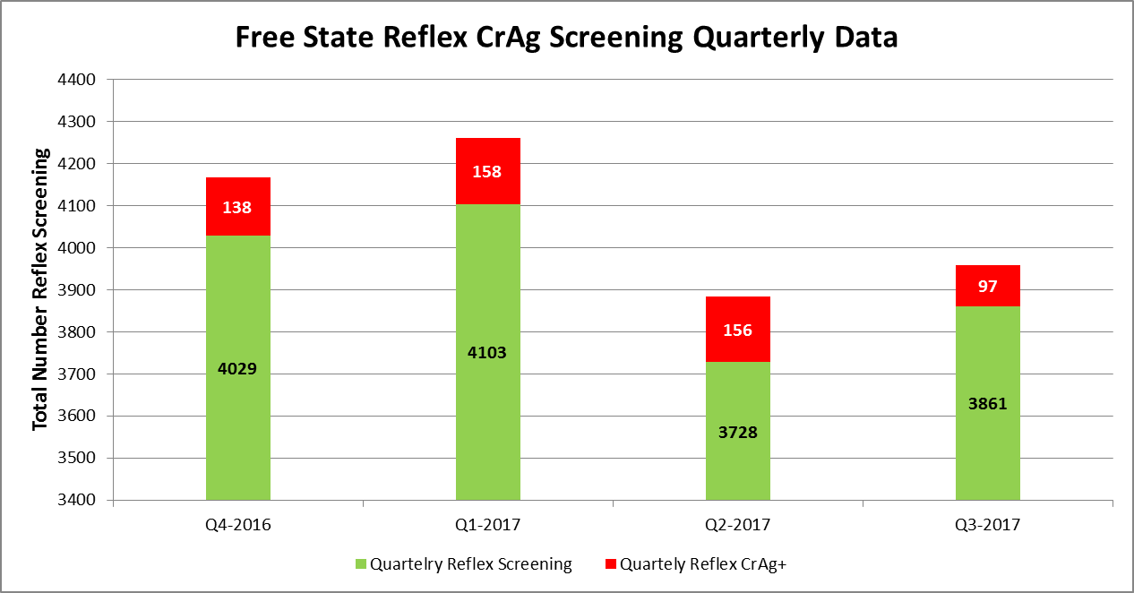
Free State | Quartelry Reflex Screening | Quartely Reflex CrAg+
Q4-2016 | 4029 | 138
Q1-2017 | 4103 | 158
Q2-2017 | 3728 | 156
Q3-2017 | 3861 | 97

