Slide 1
Single dose liposomal amphotericin for asymptomatic CRAG+ persons
Radha Rajasingham
December 10, 2017

Slide 2
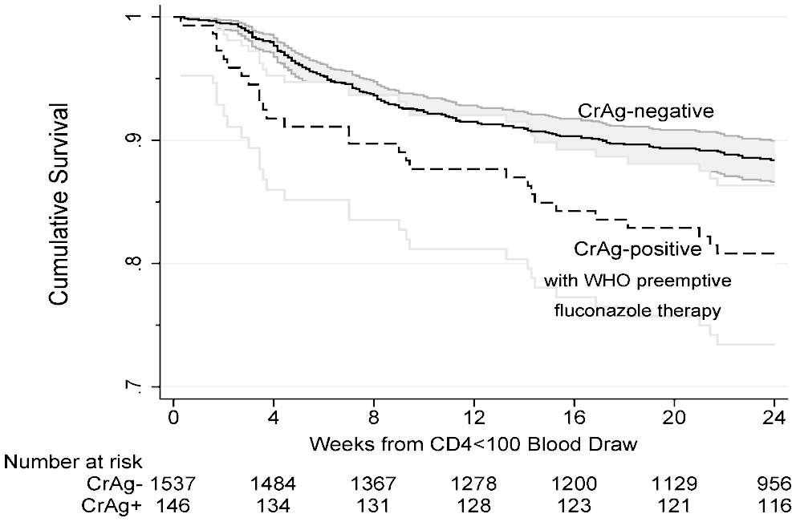
Background
Asymptomatic CRAG+ treated with fluconazole
25 to 30% failure rate with meningitis and/or death seen in Uganda (ORCAS trial) and REMSTART trial in Tanzania & Zambia

Slide 3
Proposed study
Evaluate addition of 1 dose of liposomal amphotericin (10mg/kg) to fluconazole in asymptomatic CRAG+
6-month survival
Safety and tolerability
Cost
Cost-effectiveness

Slide 4
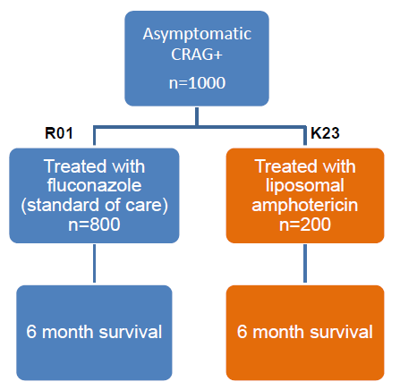
Study Design
Prospective cohort
Recruit a subset of CAST-NET study participants from high volume clinic(s)
Requires informed consent
Actively followed for 6 months
Alive/dead
Meningitis
AEs

Slide 5
Next steps
Write protocol
Site selection
Regulatory approval
Acquire ambisome –Gilead
Study coordinator

