Slide 1

NICD Daily Report and Commentary
05 October 2020

Slide 2

OUTLINE
New cases of COVID-19 and new PCR tests for SARS-CoV-2
    Number of cases
    Provincial proportions
    Testing volumes
    Proportion Positive
    Age and gender

Slide 3
New cases of COVID-19 and
new PCR tests for SARS-CoV-2
Number of new cases
The total number of cases today (n=926) is less than yesterday (n= 1 574), and less than the average number of new cases per day over the 7 preceding days (n=1 509).
The 7-day moving average daily number of cases has increased (Figure 1 – dotted red line).
The number of new cases (Table 1 and Figure 3):
  Decreased in NC (from 338 yesterday to 130 today)
  Decreased in WC (from 194 yesterday to 69 today)
  Decreased in EC (from 160 yesterday to 107 today)
  Decreased in FS (from 313 yesterday to 263 today)
  Decreased in GP (from 213 yesterday to 151 today)
  Decreased in KZN (from 119 yesterday to 86 today)
  Decreased in NW (from 93 yesterday to 52 today)
  Decreased in LP (from 77 yesterday to 32 today)
  Decreased in MP (from 67 yesterday to 36 today)
The 7-day moving average number of new cases by province is shown in Figure 2.
The cumulative number of cases to date as shown in Figure 3.
Notes:
Erratum
Please note that tests sometimes only feed from the central data warehouse into the NICD data warehouse later than the date they are processed. This can distort the daily figures.

Slide 4
Figure 1. Number of new daily PCR tests for SARS-CoV-2 and cases of COVID-19 by date of reporting and health sector, and 7-day moving average number of cases, 6 April 2020 to date, South Africa

Slide 5
Figure 2. 7-day moving average number of new cases by province and date of reporting, 12 April to date, South Africa

Slide 6
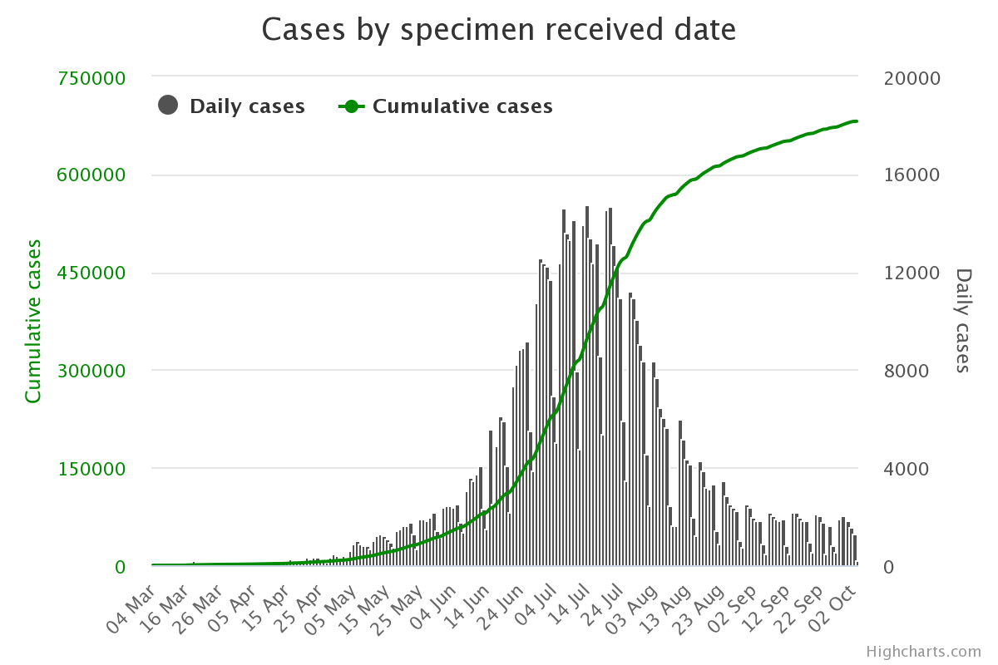
Figure 3. Cases by Specimen Received Date

Slide 7
Provincial proportions
The majority of new cases are from FS today (28%), followed by GP (16%) and NC (14%).
EC accounted for 12%, KZN accounted for 9%, NW accounted for 6%, MP accounted for 4% while LP accounted for 3%.
The proportion of new cases accounted for by WC today is 7%, lower to the preceding 7 days - Table 1 and Figure 4.
The cumulative number of cases by province is shown in Figure 5.

Slide 8
Table 1. Number and % of new daily cases of COVID-19 and PCR tests for SARS-CoV-2 and proportion positive by province as of today, South Africa
Province | New cases today | New tests reported today | Proportion positive (cases/tests) | New cases % total | New tests % total
Eastern Cape | 107 | 1049 | 10% | 12% | 10%
Free State | 263 | 1207 | 22% | 28% | 11%
Gauteng | 151 | 3165 | 5% | 16% | 30%
KwaZulu-Natal | 86 | 1595 | 5% | 9% | 15%
Limpopo | 32 | 249 | 13% | 3% | 2%
Mpumalanga | 36 | 501 | 7% | 4% | 5%
North West | 52 | 376 | 14% | 6% | 4%
Northern Cape | 130 | 621 | 21% | 14% | 6%
Western Cape | 69 | 1178 | 6% | 7% | 11%
Unknown | 0 | 773 | 0% | 0% | 7%
Total | 926 | 10714 | 9% | 100% | 100%

Slide 9
Figure 4. Proportion of new cases of COVID-19 by province and date of reporting, 6 April 2020 to date, South Africa

Slide 10
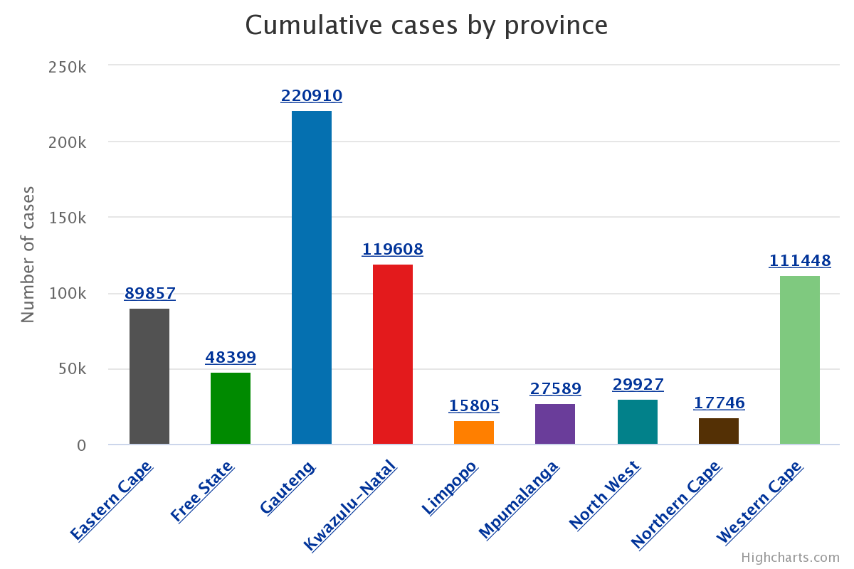
Figure 5. Cumulative cases by Province

Slide 11
Testing volumes
The volume of tests reported today (n=10 714) is 41% less than the 18 113 tests reported yesterday.

Slide 12
Proportion positive
The proportion of positive new cases/total new tested today is 10%, which is the more than yesterday (9%).
The 7-day average is 8.3% today, lower than yesterday’s 8.5 % (Figure 6 – dotted red line).
The proportions positive today were:
  Higher in FS (18% yesterday and 22% today)
  Higher in MP (6% yesterday to 7% today)
  Higher in KZN (4% yesterday to 5% today)
  Same in NW (14% yesterday to 14% today)
  Same in EC (10% yesterday to 10% today)
  Same in GP (5% yesterday to 5% today)
  Lower in NC (32% yesterday and 21% today)
  Lower in LP (16% yesterday to 13% today)
  Lower in WC (7% yesterday to 6% today)

Slide 13
Figure 6. Number of new daily PCR tests for SARS-CoV-2 and proportion positive by date of reporting and health sector, and 7-day moving average proportion positive, 6 April 2020 to date, South Africa

Slide 14
Age and Gender
The age and sex distribution of new cases has not changed substantially in the last few days (Figure 7).
Cumulative cases stratified by age group and sex is shown in Figure 8.

Slide 15
Figure 7. Age and Sex distribution of new cases of COVID-19 for the last 2 days, South Africa

Slide 16
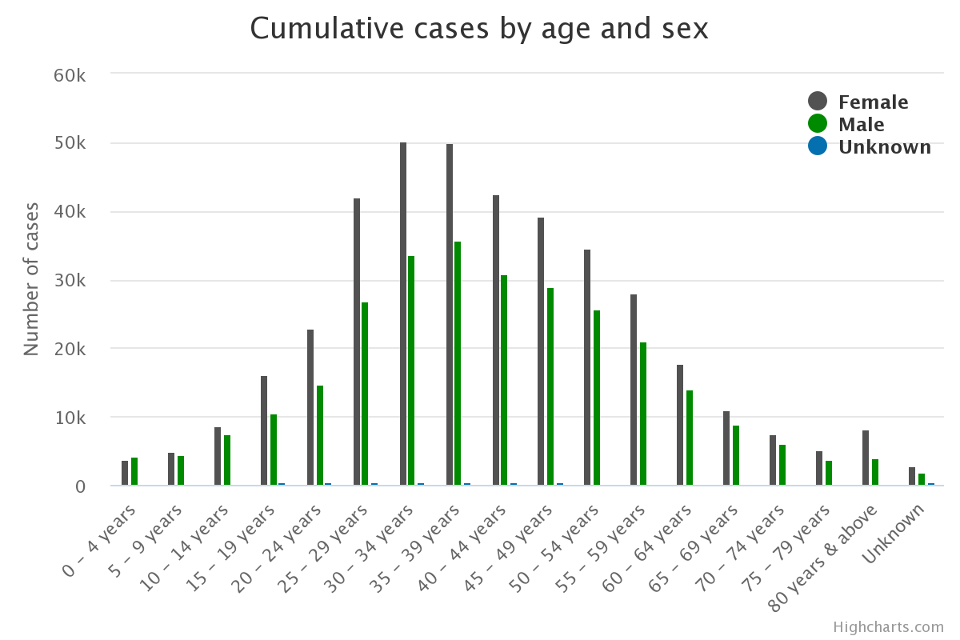
Figure 8. Cumulative cases by Age and Sex

